Slide 1
Barriers and facilitators for physical activity in people living with chronic pain: a systematic review and combined analysis.
First in the UK for Medicine (The Guardian’s University Guide 2021)
Callum Leese, Devashri Gupte, Cassie Higgins, Rebecca Skinner, Pauline Adair, Philippa Dall, Blair H. Smith, Lesley Colvin
GPST3
SCREDS Lectureship
Dundee, 27/10/23
Notes:
Introduction
Hello, I’m Callum Leese
GPST3 in Aberfeldy and Kinloch Rannoch
SCREDs Lecturer at the University of Dundee
And co-champion for physical activity and lifestyle medicine for the RCGP.
I am here to present a systematic review on the barrier and facilitators for physical activity in people living with chronic pain, done as part of the SUSSED trial.
I was a contributing member and am presenting on behalf of a wider team, and want to acknowledge the from the start. Although the research is shared, I accept all responsibility for any possible inconsistencies in the presentation!

Slide 2
Introduction
Chronic pain represents a public health emergency, with 43% of the UK adults suffering from chronic pain
Research has shown physical activity to be effective in the management of pain, with the mechanism of action likely multifactorial
Globally only 17% of the adult population meet the WHO guidelines
Physical inactivity is particularly pronounced in individuals who suffer with chronic pain
A Cochrane review assessed interventions to improve adherence to exercises in individuals with chronic musculoskeletal pain, concluding that the reasons for adherence was complex and calling for further research.
Notes:
As I am sure you are aware, chronic pain is a major public health problem, affecting 43% of UK adults.
Research has shown the physical activity is effective in the management of chronic pain, with the analgesic effect as a consequence of multiple proposed factors including: increased endogenous opioids, regenerative capacity of exercise on cutaneous nerves, increased tone and flexibility, weight loss and improved mental wellbeing.
It also has a plethora of other positive physical, psychological and social benefits.
But only 17% of the global adult population meet the WHO PA guidelines with the inclusion of the twice weekly strength and condition training. These rates are even lower in individuals suffering chronic pain.
A Cochrane review reviewing interventions to improve adherence to physical activity found a small-to-moderate effect of PA on pain severity and physical function, but highlighted a lack of good quality evidence and called for more research.

Slide 3
Aims
Systematically review the current evidence of barriers and facilitators to engagement in physical activity and exercise for adults with chronic pain
Categorize and analyse the barriers and facilitators using the COM-B model
Notes:
In order to address the findings from this Cochrane review, and guide future interventions to address barriers and utilise facilitators to physical activity we set out with two aims:
Systematically review the current evidence of barriers and facilitators to engagement in physical activity and exercise for adults with chronic pain
Categorize and analyse the barriers and facilitators using the COM-B model

Slide 4
Methods
PROSPERO registered (CRD42020219488)
INCLUSION | EXCLUSION
Peer-reviewed primary research that explored barriers to, AND/OR facilitators of, physical activity in adults(age 18 or older) with chronic pain | Review articles, opinion excerpts, protocols, conference abstracts
Published in English | Research with paediatric populations
Published from inception of databases until 4th October 2022 | Intervention not deemed to be PA (e.g. manipulation, mobilisation or passive movement)
 | Failure to define chronic pain as pain that had lasted for 3 or more months on most days
 | Exploration of sedentary behaviour without the specific inclusion of physical activity
Notes:
The systematic review was started in 2020 and registered on PROSPERO.
For inclusion research needed to be examining the barriers and/or facilitators to physical activity in adults with chronic pain, published in a peer-review paper in English.
Due to project delays it ended up being a two step analysis, with initial article screen completed in Nov 2020 and repeated update in October 2022.

Slide 5
Methods
Databases: PubMed, EMBASE, CINAHL, PsycINFO, Web of Science and Scopus
Search terms consisted of three components: pain, physical activity, and facilitators and/or barriers
Double-handed review as described by PRISMA guidelines
Single-handed data extraction using a pre-designed extraction template file
Quality appraisal via CASP checklist or MMAT V. 2018
Notes:
As per the PROSPERO guidelines 6 databases were searched
Search terms were categorised via three components, pain, physical activity and barriers/facilitators. These can be provided on request.
All articles were uploaded onto the platform Covidence, with all screened and full-text review done by two authors, with a third member involved in any discussions around disagreements.
In light of time and staffing pressures, a pragmatic decision was made for a single-handed data extraction to be performed by myself. There was a 10% check by a co-author.
Quality was assessed using 2 checklists: CASP for qualitative papers and MMAT for quanitative/mixed.

Slide 6
Methods
Qualitative analysis was performed by a single author
After coding themes were identified which were classified into the 6 sub-components of the COM-B model.
Notes:
A qualitative analysis was performed initially in a deductive nature for the identification of themes, before these were mapped to the 6 components of the COM-B behaviour change model.
The capability, opportunity and motivation behaviour change model (COM-B) is a theoretical behaviour change model that provides a framework for understanding influences on behaviour. The model presents human behaviour as a result of interaction between six elements: physical and psychological capability; physical and social opportunity; and autonomic and reflexive motivation

Slide 7
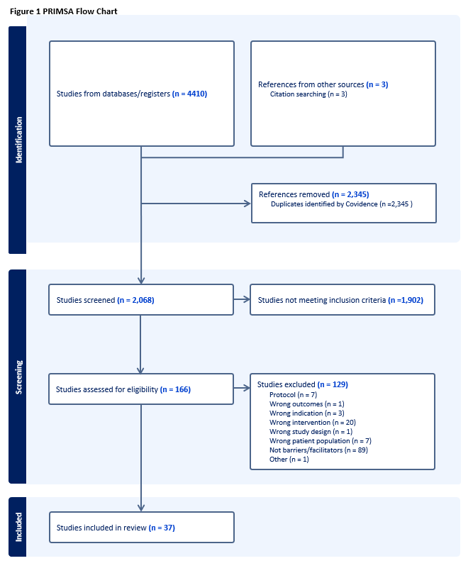
Notes:
4410 articles, including 2345 duplicates, leaving a total of 2065 articles for review
3 articles identified via cross referencing

Slide 8
Results 2
37 studies were included
Of these; 29 were qualitative, 5 were quantitative observational surveys and the remaining 3 were mixed-method studies
The total number of participants across the 37 included studies was 2116
Range of different chronic conditions
Study quality was mixed
Notes:
Ultimately 37 studies were included.
Of these the vast majority were qualitative (n=29).
A range of different conditions including: chronic lower back or neck pain (n=9), chronic musculoskeletal pain (n=6), osteoarthritis (n=5), fibromyalgia (n=2) and rheumatoid arthritis (n=1).
All studies were from Europe, North America or Australia
Study quality was mixed, with 14 deemed of high quality and the remainder of moderate or low.

Slide 9
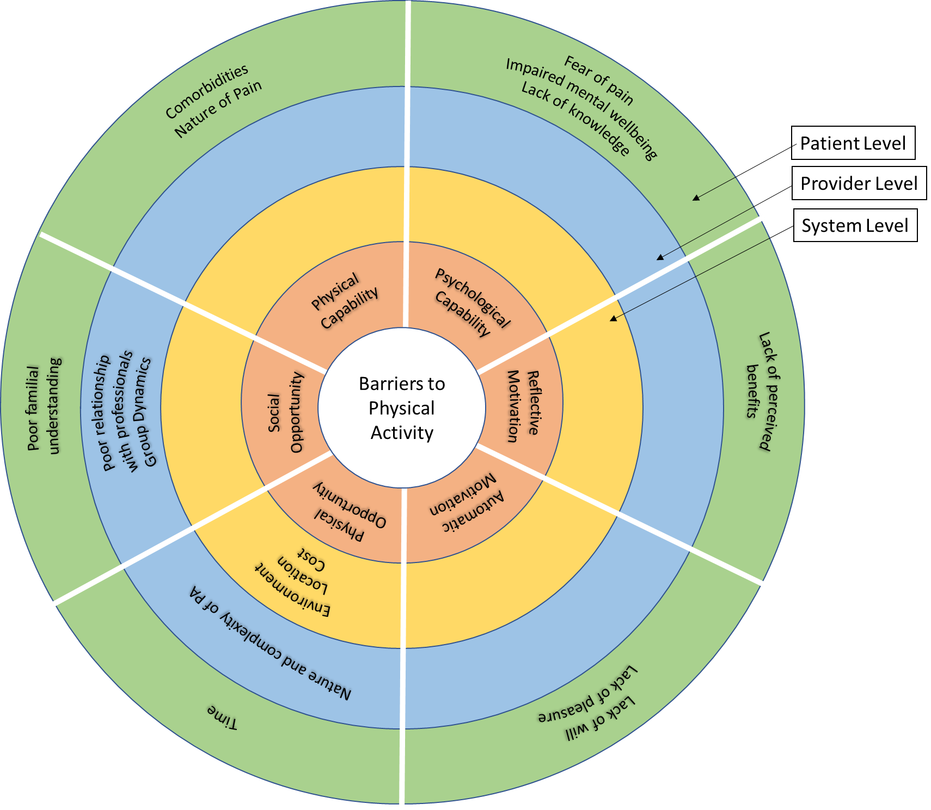
Results: Barriers
Notes:
A number of barriers existed, with the majority at the patient level, as can be seen in the diagram.
Here I have mapped the barriers within the COM-B model, and separated them by the place of influence: patient, provider or system.
The main barriers experienced by the patient include:
Lack of knowledge regarding the benefits of PA
Impaired mental wellbeing
Pain severity
Other co-morbidities
Fear of movement
Determinants of individuals social networks
At a provider level, the barriers included
Poor relationships with health and wellbeing providers
Non-supportive group dynamics (in the context of group exercise)
Type and complexity of PA advised.
At a system level location of provision of PA, cost of access and weather all act as barriers.

Slide 10
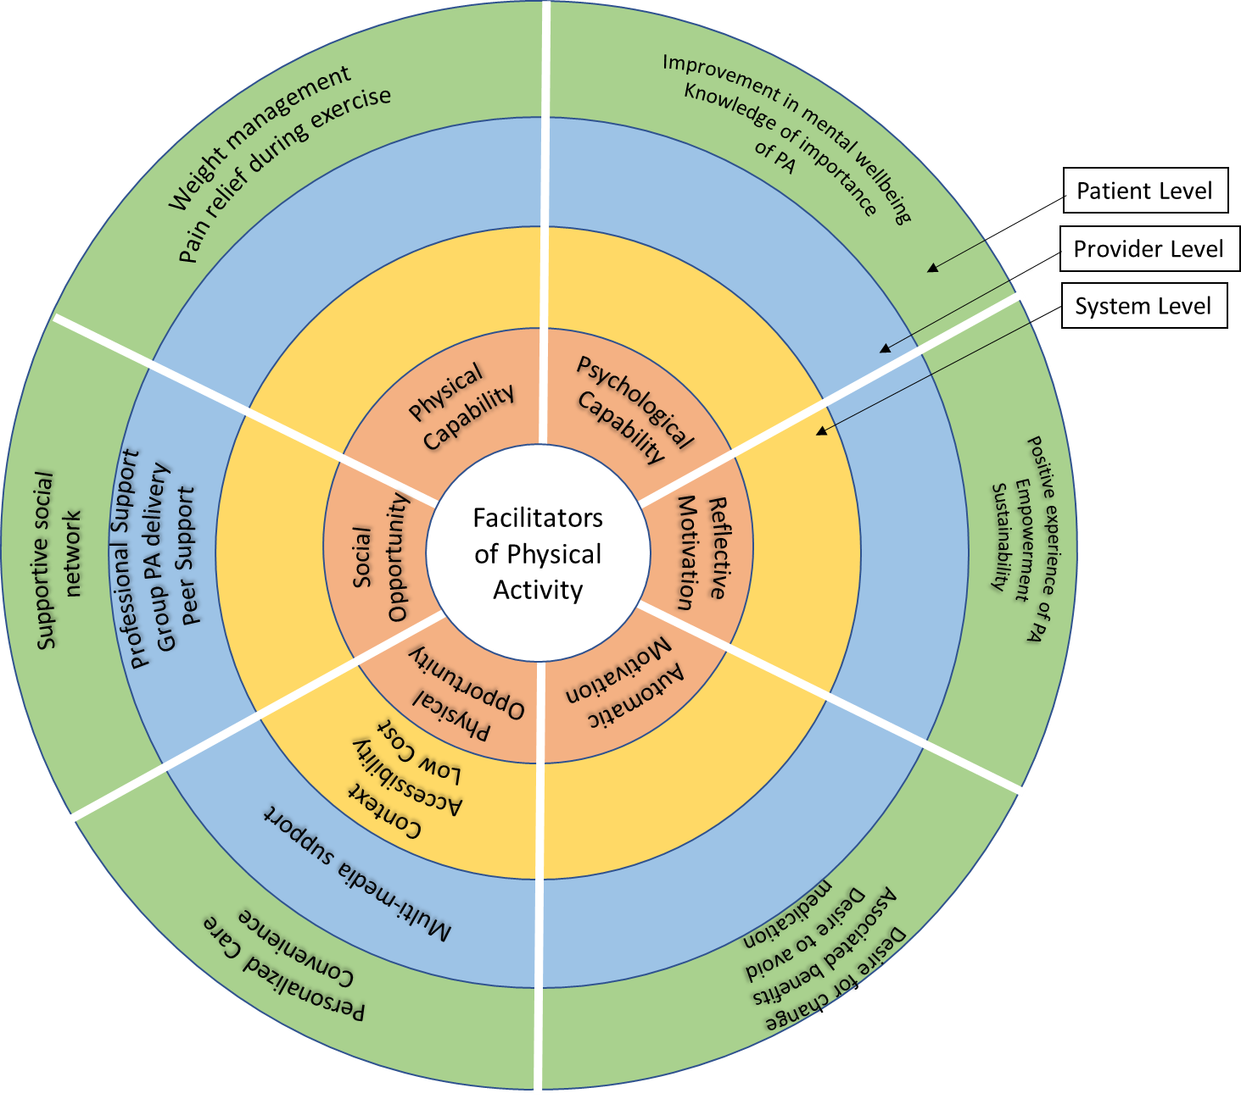
Results: Facilitators
Notes:
Similarly, to the previous slide I have mapped the facilitators of physical activity.
Many of these represent the reverse of the barriers but I wanted to highlight a number of patient factors: supportive social network, a belief in the personalisation of care, experience of the benefits (e.g. pain relief during exercise, weight management, empowerment).
At a provider level a high degree of professional support, peer support and multi-media support were all positively experienced as facilitators
Finally at a system level, alongside low cost and ease of accessibility context was deemed important. One paper highlighted that PA delivered in sports and leisure facilities (‘a wellbeing context’) was less stigmatising than a health setting.

Slide 11
Key Outputs
Main Barriers | Key Facilitators
Higher pain severity | Person-centred PA delivery
Presence of comorbidities | Good social support
Lack of knowledge | Education regarding benefits of PA
Time Constraints
Addressing these barriers and leveraging facilitators is crucial for successful future interventions, addressing gaps highlighted in the Cochrane Review
Notes:
So in summary, these are key outputs as weighted by citation number.
The main barriers: high pain severity, presence of comorbidities, a lack of knowledge and personal time pressures
The key facilitators: person-centred delivery, good social support, and education regarding benefits of PA.
Addressing these barriers and leveraging facilitators is crucial for successful future interventions, addressing gaps highlighted in the Cochrane Review.

Slide 12
References

Slide 13
First in the UK for Medicine (The Guardian’s University Guide 2021)
Dr Callum Leese

